Slide 1
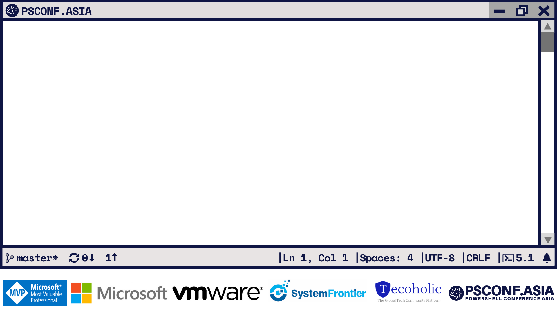
Real world REST API building with PowerShell in Azure Functions
Terraform Registry!
Ben Gelens MVP CDM, Consultant Wortell Enterprise Security

Slide 2
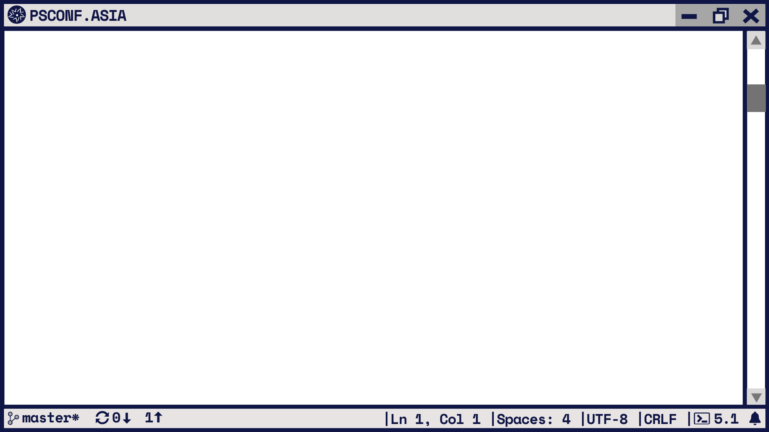
Agenda:
Azure Functions
PowerShell in Azure Functions
Development requirements
Demo: Introduction
Terraform
10.000ft
Public registry
Private registry
How to start building your private registry
Demo: interacting with Public registry using PowerShell Module
Design
Demo: develop Terraform Private Registry as Azure Functions using PowerShell

Slide 3
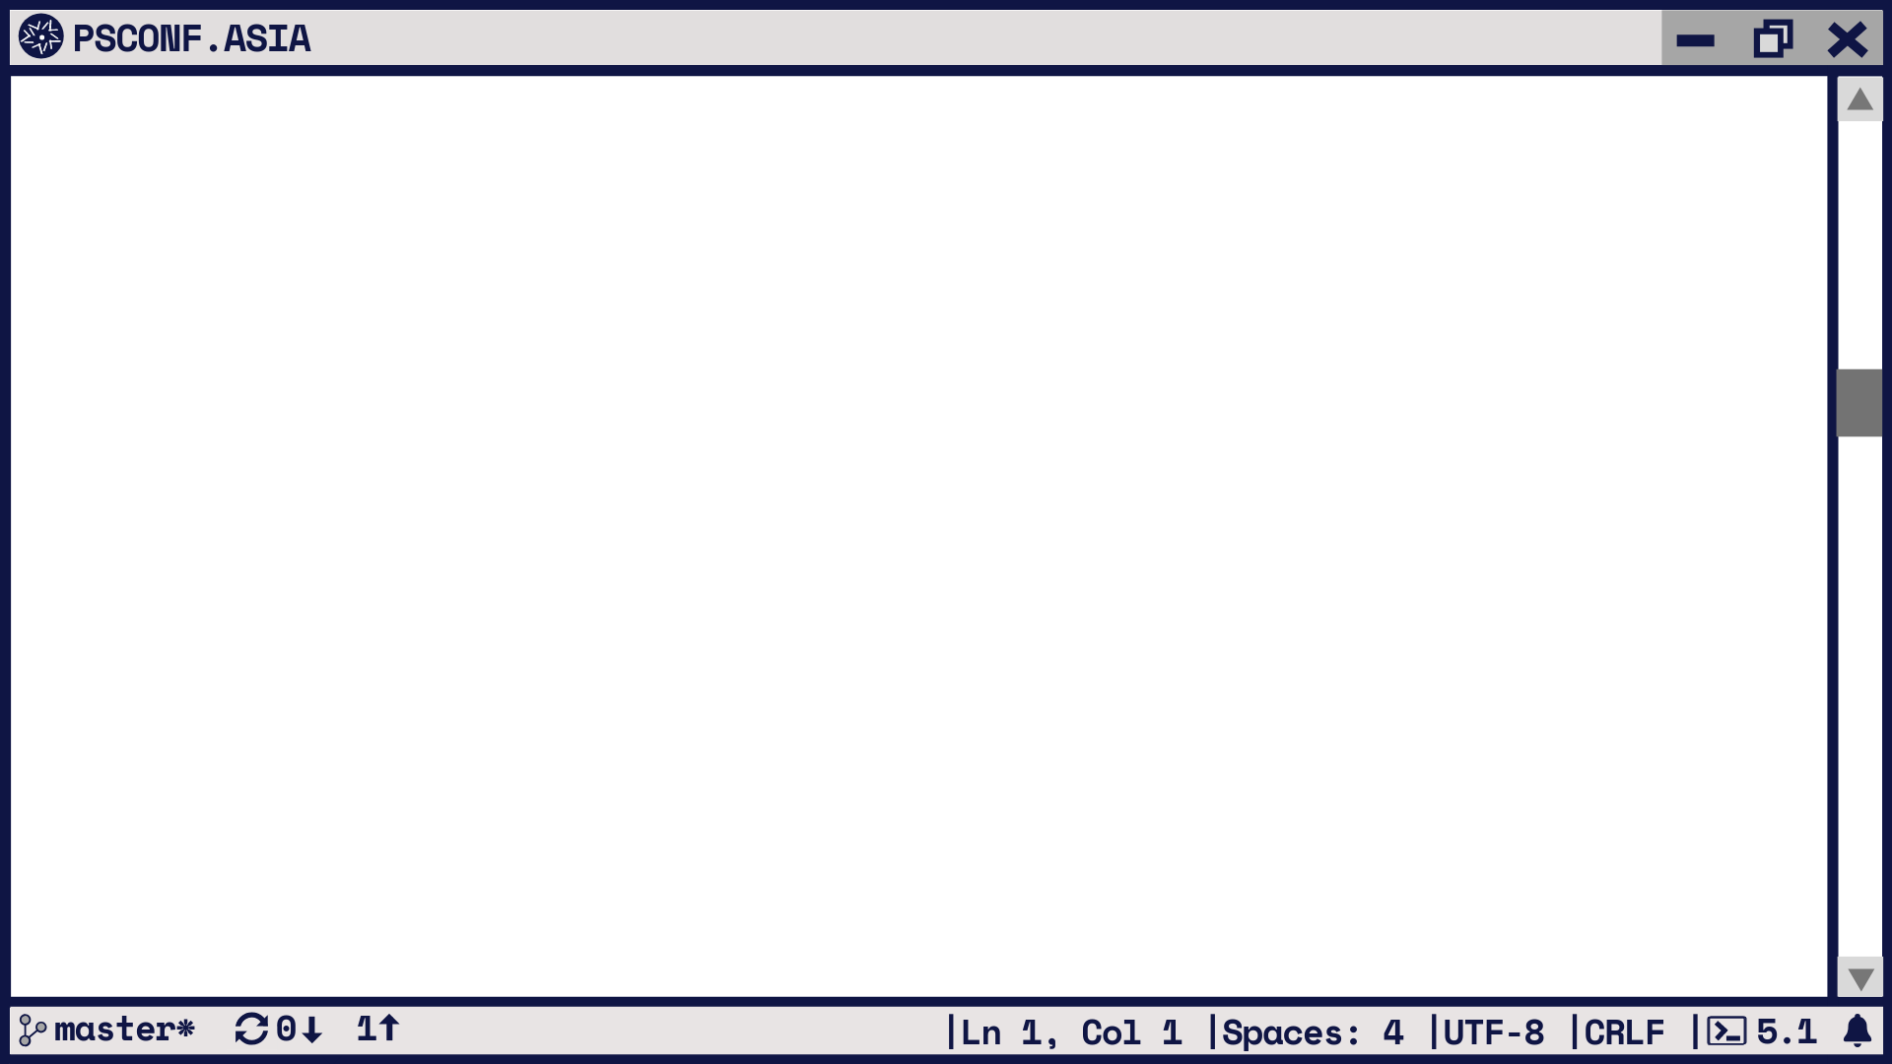
PowerShell in Azure Functions:
Azure Functions is a solution for easily running small pieces of code, or "functions," in the cloud. You can write just the code you need for the problem at hand, without worrying about a whole application or the infrastructure to run it.
And now you can write that code in PowerShell! (Public Preview support)
Framework which allows for easy development
A lot of Triggers & Bindings support (Event driven)
Free consumption plan / Premium plan / Dedicated plan
Windows / Linux / Containers
……
Simply too much to tell (in 45 min), let’s just dive in to make things clearer!

Slide 4
Development requirements:
Required for PowerShell functions:
Dotnet core 2.2 sdk
Azure Functions Core Tools https://github.com/Azure/azure-functions-core-tools
Extra to make things easier:
VS code +
PowerShell Extension
Functions Extension
Az cli 2.0 / Az PowerShell (logged in)
Azure Storage Emulator (not available on Mac / Linux)
will be / is replaced with Azureite which is xPlat https://github.com/azure/azurite
Azure Storage Explorer

Slide 5
Demo
Azure Functions introduction

Slide 6
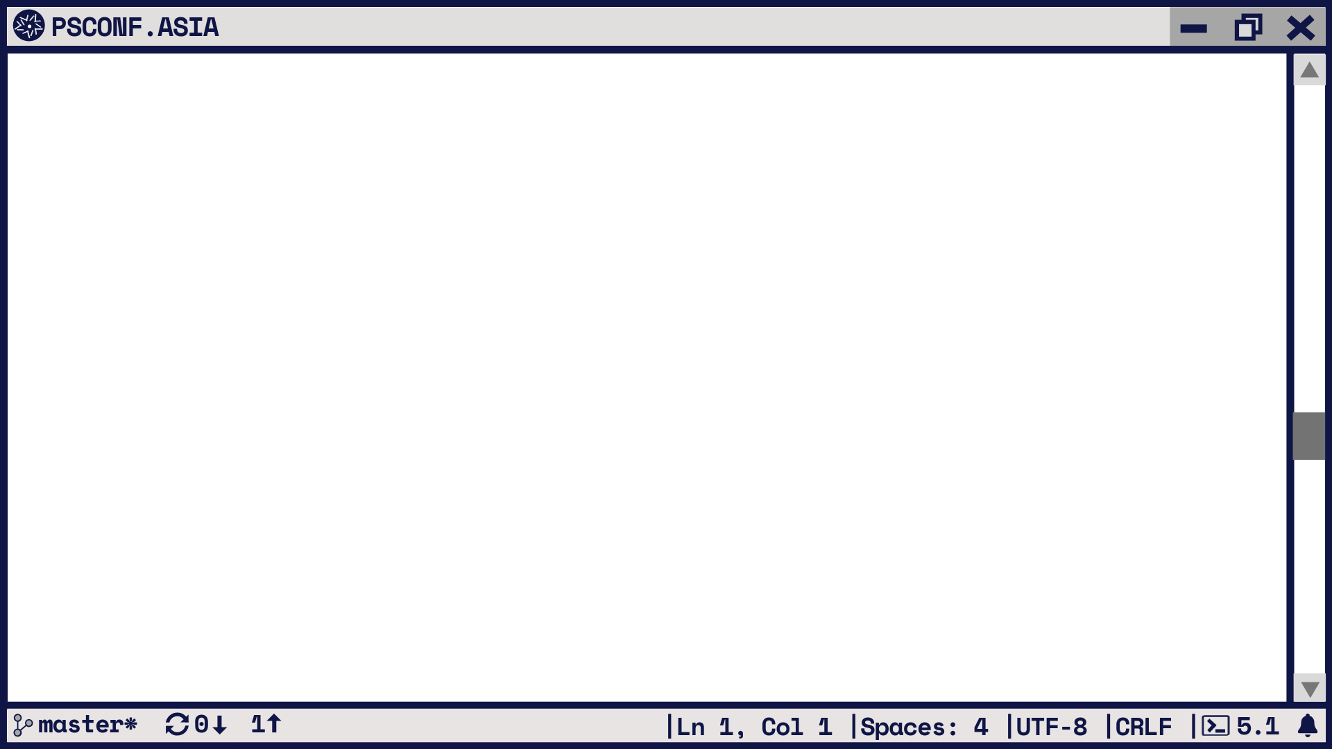
What is Terraform 10.000ft:
Terraform is a tool for building, changing, and versioning infrastructure safely and efficiently (IaC). Terraform can manage existing and popular service providers as well as custom in-house solutions.
Add provider (e.g. Azure, AWS, etc.)
Write using one language (HCL)
Reusable code artifacts in the form of Modules

Slide 7
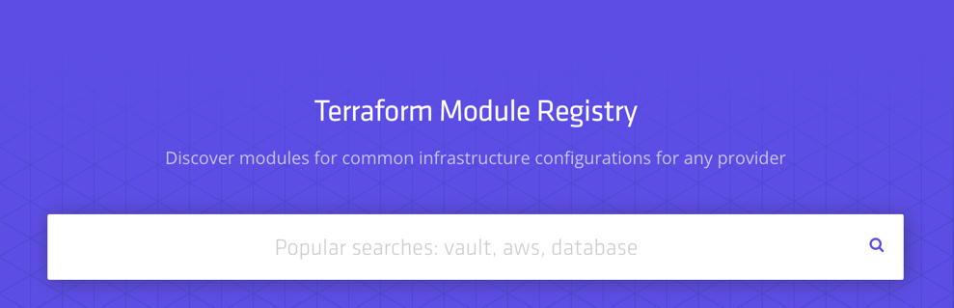
Terraform Public Registry:
Public registry where anyone can publish their module:
Requires the module to live on GitHub
Anyone can download
Anyone can publish (with a GitHub account)
Some are verified publishers (e.g. Microsoft)
Finding and Using Modules:
https://www.terraform.io/docs/registry/modules/use.html
https://registry.terraform.io/
module "psconfasia" {
source = "bgelens/psconf/asia"
version = "0.1.0"
}
terraform init

Slide 8
Terraform Private Registry:
Commercial private registry available through Terraform Enterprise offering https://www.hashicorp.com/products/terraform/offerings
Using other references as source: (local paths, GitHub, Git, HTTPs, etc.) More options see: https://www.terraform.io/docs/modules/sources.html
Or you could…: Create your own private registry!
No need to create complex project structures for nesting Modules
Host Public curated modules
Private per module CI/CD pipeline with CD to private registry
Explicit versioning
Offer your modules commercially?

Slide 9
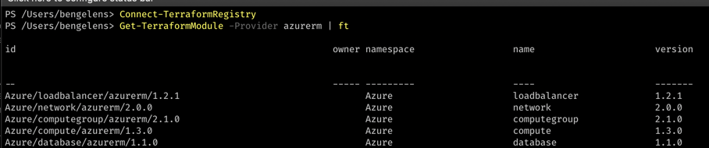
Demo
PowerShell as a client

Slide 10
Design
Table storage for quick lookups of existing modules, version and keep track of number of downloads
Blob storage to store and serve out tar.gz compressed modules
Blob triggered function to ingest modules placed in blob storage and make
an entry in table storage

Slide 11
Design
Lookups in Table Storage
Http trigger:
Service discovery (.well-known)
List Modules
Get Module Latest Version
Get Module Explicit Version
Get Module Versions
Get Module Download Link (Get link from Table, generate blob read SAS token)
Download blob

Slide 12
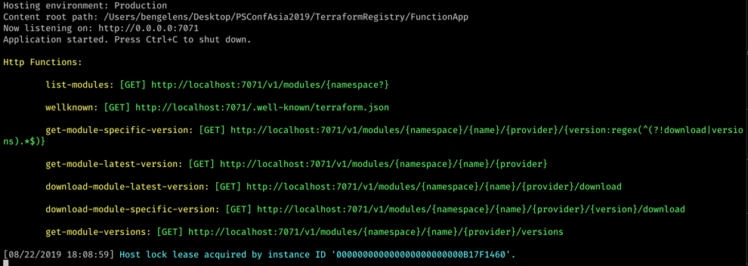
Demo
Develop Terraform Private Registry as Azure Functions using PowerShell

Slide 13
